Slide 1
World drifts toward war

Slide 2
Objective:
Students will examine and discuss the aggressive behaviors of totalitarian regimes and the lack of protection from the League of Nations as measured through their Cornell notes, QW, class discussion, and exit slip.

Slide 3
Setting the stage
Mid 1930s
Major democracies – Britain, France, & U.S. were distracted by economic problems
Germany and Italy focused on military conquest
Many hoped that the League of Nations would help to establish peace

Slide 4
JTPS
What was the League of Nations? When and why was it created? Explain in detail.

Slide 5
Japan
Japan invades various islands in SE Asia, which directly challenged the League of Nations
1937, Japan invades China and fights both Jiang Jieshi and Mao Zedong
Beijing, Nanjing (capital of China), as well as other Chinese cities fell to the Japanese
Japanese killed tens of thousands of soldiers and civilians in what was called “the rape” of Nanjing

Slide 6
Italy
League’s failure to stop the Japanese encouraged Mussolini to plan an attack on Africa
Italy still upset that they did not receive any territory for winning WW1
Took over Ethiopia in 1936
Ethiopians pleaded with League to help
League condemned the attack, but had no real power to stop Italy

Slide 7
Germany
Hitler defies Versailles Treaty
Expanded Germany’s army and military
League’s failure to take action convinced Hitler to take even greater risk
Treaty stated that German Troops could not enter the Rhineland
1936, German troops moved into the Rhineland
The French were shocked and angry but did not do anything about it

Slide 8
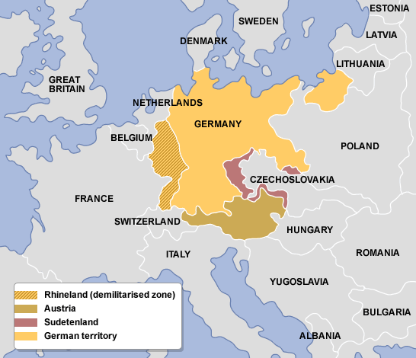

Slide 9
Appeasement
Appeasement- giving in to an aggressor to keep peace
German reoccupation of the Rhineland marked a turning point in the march toward war
Strengthened Hitler’s power and prestige within Germany
Balance of power changed to Germany’s favor
The weak response by France and Britain encouraged Hitler to speed up his military and territorial expansion

Slide 10
The Axis Powers
Hitler’s growing strength convinced Mussolini that he should seek an alliance (Oct. 1936)
A month later, Japan joins Hitler and Mussolini
The three are known as the Axis Powers

Slide 11
QW #10 – Appeasement
What is the policy of appeasement and what is it’s purpose? List and describe some of the positives and negatives about this policy. Why was the League of Nations so adamant about this policy? Explain.
(1 paragraph)

