Slide 1
Japan Strikes in the Pacific

Slide 2
Objective:
Students will investigate and elaborate on the reasons that push the U.S. into WWII as measured through their Cornell notes, video analysis, QW, discussion, and exit slip.

Slide 3
Setting the Stage
Japan was overcrowded and faced shortages of raw material
Was promised territory after WW1, but the Allies did not keep their promise
To solve these problems and to encourage nationalism = Japan began to expand

Slide 4
A Pacific Empire
Japan had taken over Manchuria and swept into the heartland of China
Caused a strain on Japan’s economy
Japan looked toward colonies in Southeast Asia
Japan wanted the Philippine Islands and Guam
These two colonies belonged to the U.S.

Slide 5
The U.S.
Feared that Japan will take over their two colonies
Sent aid to China
Cut off oil shipments to Japan

Slide 6
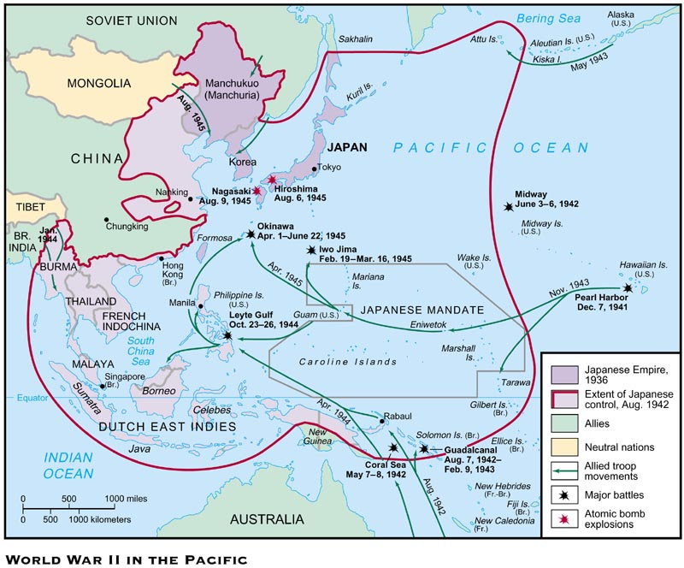

Slide 7
Pearl Harbor
Isoroku Yamamoto
Admiral for the Japanese naval fleet
Believed that the U.S. fleet in Hawaii was a threat to Japanese expansion and must be destroyed
Dec. 7, 1941
Led a surprise morning attack on Pearl Harbor in Hawaii
“A date which will live in infamy”
President Roosevelt

Slide 8
Pearl Harbor
Sunk 18 ships – including 8 battleships
2,400 Americans were killed
1,000 more wounded
The next day, Congress declared war on Japan

Slide 9
The Tide of Japanese Victories
After Pearl Harbor, Japan seized Guam and Wake Island in the Western Pacific
1942, the Philippine, Hong Kong, Java, Sumatra, Borneo, Celebes, and Burma fell to Japan
With the fall of Burma, it seemed like the Chinese were going to surrender

Slide 10
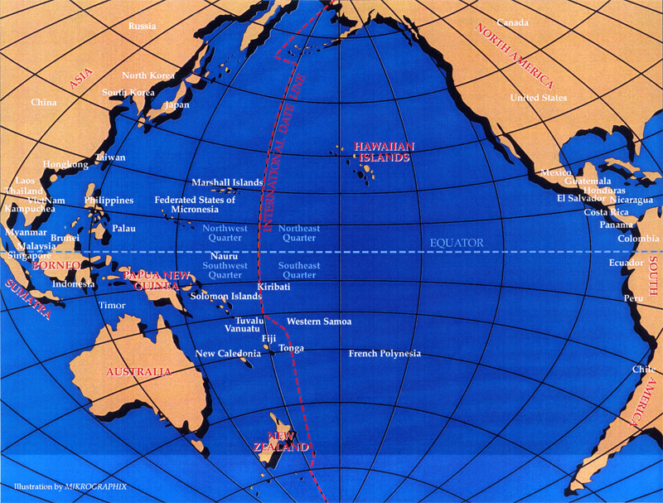

Slide 11
QW #20 – Pearl Harbor
Was Pearl Harbor a good enough reason for the U.S. to enter WWII? Explain your reasoning.
Think about the U.S. policy of Isolationism
Think about the horrors of WWI
1 paragraph

