Slide 1
Collapse of the Soviet Union

Slide 2
Objective:
Students will investigate the flaws of the Soviet Union and be able to determine why it collapsed as measured through their Cornell notes, mini quiz, discussion, and exit slip.

Slide 3
Setting the Stage
Reforms of the 1980s brought a lot of hope to the Soviet Union and Eastern Europe
First time in decades, they were able to make choices
Soon discovered that increased freedom=challenges social order

Slide 4
Baltic Nations defies Gorbachev
Controlled by the Soviets since 1940
March 1990
Lithuania declares its independence
Gorbachev forces blockade to maintain control
Gorbachev goes too far and attacks citizens

Slide 5
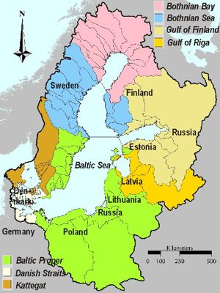

Slide 6
The August Coup
Hard-liners- conservatives who opposed change and reform
Wanted to take Gorbachev out of power as they did not like his democratic ways
Detained Gorbachev at his vacation home
However, Soviet people lost their fear of the party and were willing to defend their freedoms (Did not matter who ruled the committee)

Slide 7
Justify Think Pair Share
What was the August Coup? Who was involved in it and why? Explain.

Slide 8
End of the Soviet Union
Countries began to declare their independence from the Soviet Union
December 1991
All 15 republics had declared independence
Soviet Union ceased to exist

Slide 9
The Yeltsin Era
As President of the large Russian Republic, Boris Yeltsin was the first President directly elected
Adopted a plan known as “shock therapy”- an abrupt shift to free-market economics
Eliminated gov. involvement to the economy
Removed price controls
Economic problems caused more of a shock and eventually put Vladamir Putin (current President of Russia) into power

Slide 10
Justify Think Pair Share
What type of government and economy did Russia become when the Soviet Union collapsed? In your opinion, why did this happen?

